Slide 1
INPUTS
Koi
Type
Color
Pattern
Image
Food
Name
Description
Nutrients
Effects
Disease
Name
Description
Cure
Tank
w/ family per square/inches
w/ non-family per square /inches
w/ other species per square /inches
Sensor
Ph Level
Water Temperature

Slide 2
PROCESS
Recording all information on specific Koi
Reading and converting sensor values to human readable value.

Slide 3
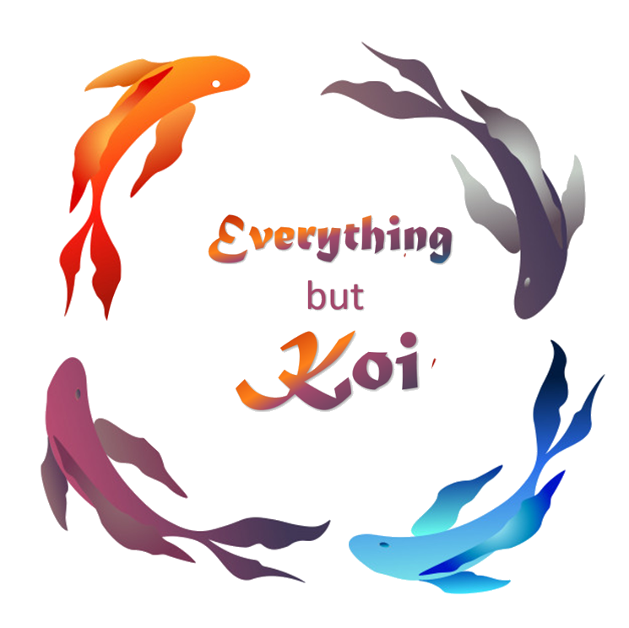
OUTPUT
KOI DISEASE MONITORING SYSTEM

Slide 4
EVALUATION / FEEDBACKING
ISO 25010:2011

Slide 5
INPUTS
PROCESS
OUTPUT
Koi
Type
Color
Pattern
Image
Food
Name
Description
Nutrients
Effects
Recording all information on specific Koi
Disease
Name
Description
Cure
KOI DISEASE MONITORING SYSTEM
Tank
w/ family per square/inches
w/ non-family per square /inches
w/ other species per square /inches
Reading and converting sensor values to human readable value.
Sensor
Ph Level
Water Temperature
EVALUATION / FEEDBACKING
ISO 25010:2011

Slide 6
